Slide 1



Join our community!
Receive regular updates from our community experts and exclusive invites to our community events and workshops.
https://aka.ms/devMY

Slide 2


Microsoft Learn – Free!
Build your skills fast with free, interactive tutorials at
Microsoft Learn, a new training experience for technical users.
Step-by-step training to fit your schedule
Interactive coding environments for hands-on experience
Earn achievements and recognition for your Azure skills
Start today at Microsoft.com/Learn

Slide 3


Manage your Data Science pipeline with Python and Visual Studio Code
13 September 2020
Joao Bilhim
Asia AI & Machine Learning Specialist Manager
Notes:
Link to meeting room: https://streamyard.com/kpwk25r2a3

Slide 4




Hello and Welcome everyone!
Session contents:
http://github.com/joaobi/pycon2020
@joaobi
https://github.com/joaobi
https://www.linkedin.com/in/joaobi/

Slide 5
Agenda
1 | Vision Studio Code for Python Latest updates for Data Science and Python
2 | DEMO Using Notebooks inside VS Code
3 | Azure Machine Learning Service The service, Python SDK and VS Code extension
4 | DEMO Train and Deploy a ML model without leaving VS Code
Notes:
Slides on …
Demo:
https://aka.ms/pythonvscode
Open Visual Studio Code, install Python extension
..
..
.
https://devblogs.microsoft.com/python/python-in-visual-studio-code-august-2020-release/
Support for multiple Python interactive windows
Notebooks:
https://devblogs.microsoft.com/python/notebooks-are-getting-revamped/
https://devblogs.microsoft.com/python/python-in-visual-studio-code-july-2020-release/ - Gather extension, Exporting Notebooks to HTML and PDF,
..
Demo
https://devblogs.microsoft.com/python/enhance-your-azure-machine-learning-experience-with-the-vs-code-extension/

Slide 6
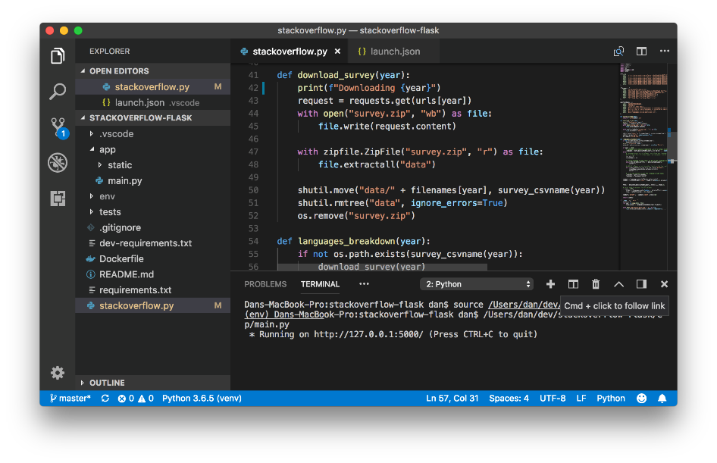
Visual Studio Code
Built-in language support
IntelliSense
Debugging
Free, cross-platform, open source
Fast and lightweight
Rich extension ecosystem
Most popular IDE (Stackoverflow 2019)
Source Control
Notes:
https://insights.stackoverflow.com/survey/2019#development-environments-and-tools

Slide 7
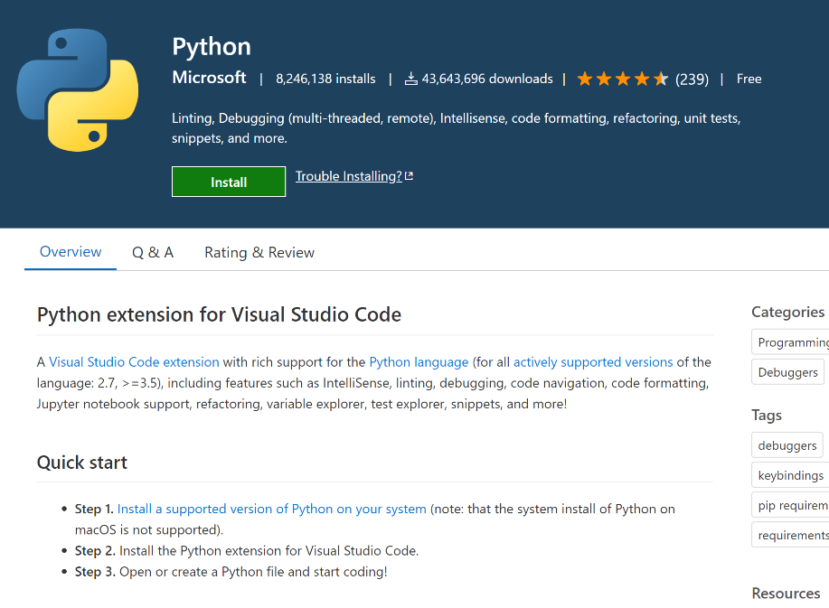
Python Extension
+
2016: Started
2017: Microsoft
2020: +24k installs, 2nd Most used IDE for Python*
Most popular extension on the Visual Studio Code marketplace
Adds Python support: IntelliSense, Debugging, Linting, Testing, Refactoring, Jupiter Notebooks
* https://www.jetbrains.com/lp/python-developers-survey-2019/
Notes:
https://www.jetbrains.com/lp/python-developers-survey-2019/

Slide 8

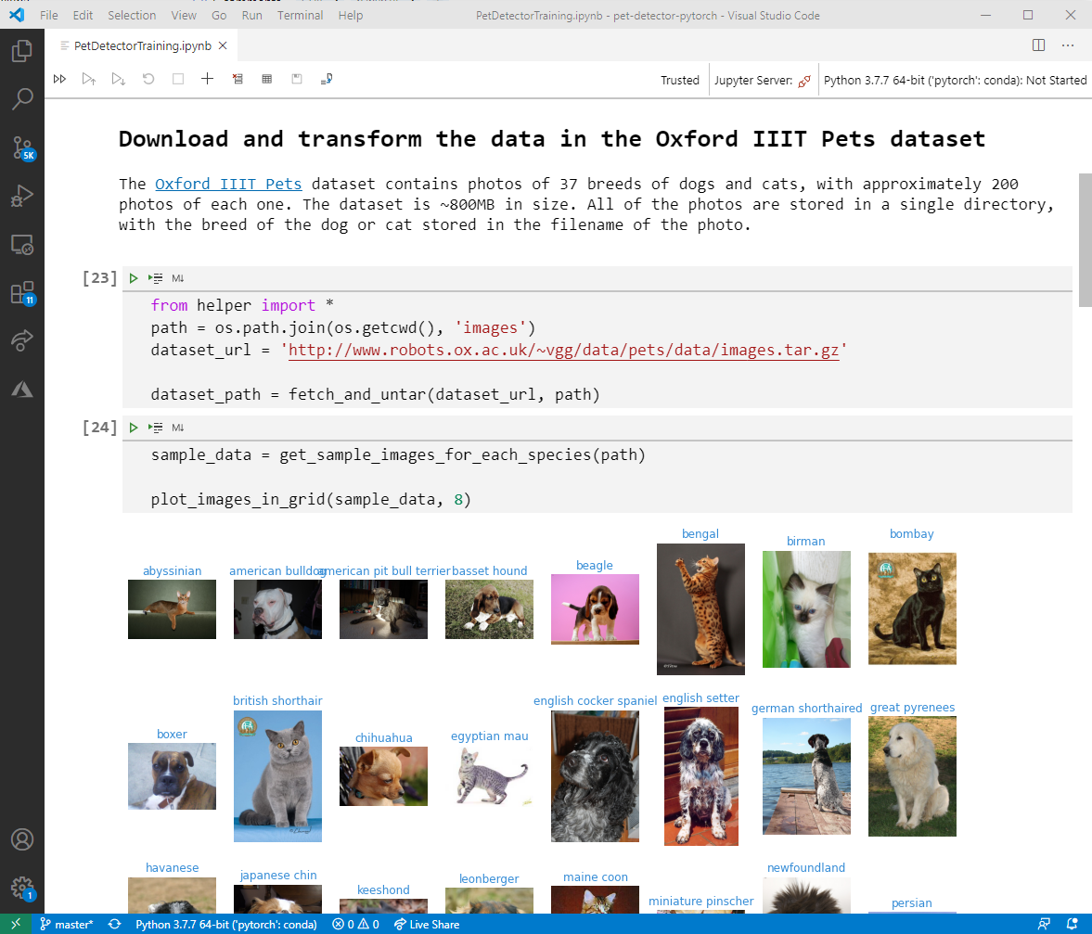
Data science with Python in VS Code
Bring together the power of Jupyter Notebooks and VS Code
Work with ipynb files directly inside VS Code
Convert Jupyter Notebooks into Python scripts
Connect to local / remote Jupyter servers
Visualize data frames and plots: Data and Plot Viewers
Integrated IPython console
Variable Explorer
Full IntelliSense
Cell Debugging
Real-time collaboration on Notebooks

Slide 9
Demo
Using Notebooks inside VS Code
Open VS Code
Install the Python Extension
“Hello PyCon APAC 2020”
Explore the IDE and Extension
Intro to Notebooks
Notes:
Hello World
Open VSCode and Add extension
Explain environment and change environment
Create new file, print Hello World
Add # %% (show Interactive Python window)
Create new NB (explain you can do that with new file or Using CTRL+SHIFT +P and Python:….)
Explain NB interface
Do hello world on the NB
CTRL Enter vs run
More complex example (Strava)
Explain demo
Go line by line
Show Variables
Show Data Viewer
Show Plot Viewer
Run by line (aka Debug)
Convert to Python Script
Gather Notebook
…

Slide 10

Azure Machine Learning service
Productive
MLOps
Open platform
Notes:
Productive, Open platform

Slide 11


Azure ML Platform
Machine Learning Workspace
Data Science Experiences
SDK / CLI / Drag & Drop, VSCode, JupyterLab
MLOps
Asset management for the E2E ML Lifecycle
Dataset Management
Model Training
Model Management
Model Serving
Compute
Storage
Orchestration
Notes:
https://docs.microsoft.com/en-us/azure/machine-learning/concept-azure-machine-learning-architecture?view=azure-ml-py
Productive, Open platform

Slide 12













Workspace (Network Security, Encryption, RBAC)
Data
Associated Azure Services
Internet
Azure Storage Service
Storage
Key Vault
Container Registry
Scoring Request
(TLS/SSL)
Model Development
Webservice (Private IP)
Build
Train
Deploy
Monitor
VPN
Gateway
Express Route
Compute Instance
Compute Cluster
AKS Cluster
App Insights
Enterprise
Deploy Model
Retrain Model
Customer Virtual Network
Notes:
https://docs.microsoft.com/en-us/azure/machine-learning/concept-workspace?view=azure-ml-py

Slide 13

Machine learning Democratization
Analysis Pro
Visual Interface
Python SDK
Notebooks
No code
With code
Automated ML
UI
Automated ML Python
Cognitive Services Notebooks
Analysis Beginner

Slide 14
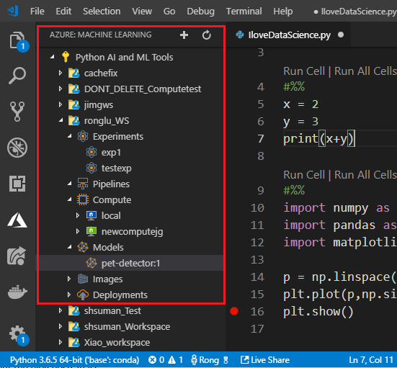
Azure Machine Learning extension for VS Code
Work with AML services from within VS Code
Manage workspaces
Submit and Debug experiments
Register models
Deploy services
View pipelines
Connect to remote Jupyter servers

Slide 15


Demo
Train and Deploy a model without leaving VS Code
Build a model on local machine
Build a model on compute instance
Build and deploy on compute clusters
Notes:
Hello World
Open VSCode and Add extension
Explain environment and change environment
Create new file, print Hello World
Add # %% (show Interactive Python window)
Create new NB (explain you can do that with new file or Using CTRL+SHIFT +P and Python:….)
Explain NB interface
Do hello world on the NB
CTRL Enter vs run
More complex example (Strava)
Explain demo
Go line by line
Show Variables
Show Data Viewer
Show Plot Viewer
Run by line (aka Debug)
Convert to Python Script
Gather Notebook
…

Slide 16
Demo 1 : Durian vs Jackfruit Classifier
Local Machine
Local Machine
Local data
Local compute
Local Notebook Server

Slide 17


Demo 2 : Durian vs Jackfruit Classifier
Compute instance
Azure ML
Workspace
Compute instance
Data Store
Local Machine
Remote data
Remote compute
Remote Notebook server
AML Python SDK
Access anywhere
Preconfigured for ML
Fully customizable: Size, CPU/GPU, …

Slide 18

Demo 3 : Durian vs Jackfruit Classifier
Compute cluster
Azure ML
Workspace
Compute clusters
Data Store
Local Machine
Shared compute
On-demand
Docker Images
Preconfigured for ML
Fully customizable: Size, CPU/GPU, …
Remote data
Remote compute
Remote Notebook server
AML Python SDK
Distrib. computing
Webservice
Container Instance
Container Registry

Slide 19
Wrap-up
 | Vision Studio Code for Python Using VS Code and the Python extension to Explore data using Notebooks
 | Azure Machine Learning Service Using Azure Machine Learning Service and Extension to build, train and deploy models
Notes:
Slides on …
Demo:
https://aka.ms/pythonvscode
Open Visual Studio Code, install Python extension
..
..
.
https://devblogs.microsoft.com/python/python-in-visual-studio-code-august-2020-release/
Support for multiple Python interactive windows
Notebooks:
https://devblogs.microsoft.com/python/notebooks-are-getting-revamped/
https://devblogs.microsoft.com/python/python-in-visual-studio-code-july-2020-release/ - Gather extension, Exporting Notebooks to HTML and PDF,
..
Demo
https://devblogs.microsoft.com/python/enhance-your-azure-machine-learning-experience-with-the-vs-code-extension/

Slide 20
Resources
 | Session contents http://github.com/joaobi/pycon2020 @joaobi
 | Python @Microsoft @pythonvscode Python in VS Code Python on Azure Microsoft on PyPI https://aka.ms/notebooks
 | Azure Machine Learning Azure Machine Learning Service site and docs Azure Machine Learning extension for VS Code aka.ms/aml-extension AI Certifications: https://aka.ms/ai-certs
Notes:
Slides on …
Demo:
https://aka.ms/pythonvscode
Open Visual Studio Code, install Python extension
..
..
.
https://devblogs.microsoft.com/python/python-in-visual-studio-code-august-2020-release/
Support for multiple Python interactive windows
Notebooks:
https://devblogs.microsoft.com/python/notebooks-are-getting-revamped/
https://devblogs.microsoft.com/python/python-in-visual-studio-code-july-2020-release/ - Gather extension, Exporting Notebooks to HTML and PDF,
..
Demo
https://devblogs.microsoft.com/python/enhance-your-azure-machine-learning-experience-with-the-vs-code-extension/

Slide 21
Join our community!
Receive regular updates from our community experts and exclusive invites to our community events and workshops.
https://aka.ms/devMY

Slide 22
Microsoft Learn – Free!
Build your skills fast with free, interactive tutorials at
Microsoft Learn, a new training experience for technical users.
Step-by-step training to fit your schedule
Interactive coding environments for hands-on experience
Earn achievements and recognition for your Azure skills
Start today at Microsoft.com/Learn

